Slide 1

LONGITUDINAL DATA
UPLIFTING THE NARRATIVE IN

Slide 2


Joe Munnich
Amanuel Medhanie
Executive Director,
Generation Next
Consultant (Parsimony)
with Generation Next

Slide 3

Longitudinal Data
Notes:
Tie 4 Million Futures and Pathways to this presentation.
"A longitudinal design is one that measures the characteristics of the same individuals on at least two, but ideally more, occasions over time. Its purpose is to address directly the study of individual change and variation.“- Hofer, S., & Piccinin, A. (2010). Longitudinal design. In Encyclopedia of research design (Vol. 0, pp. 741-744). SAGE Publications, Inc., https://doi.org/10.4135/9781412961288.n226

Slide 4
Longitudinal Design
"A longitudinal design is one that measures the characteristics of the same individuals on at least two, but ideally more, occasions over time. Its purpose is to address directly the study of individual change and variation."
- Hofer, S., & Piccinin, A. (2010). Longitudinal design. In Encyclopedia of research design (Vol. 0, pp. 741-744). SAGE Publications, Inc., https://doi.org/10.4135/9781412961288.n226
Notes:
Ask audience about experiences with Longitudinal data (either using it or being part of it)
*Focus on the longitudinal part of this (questions). “Relates to data over time about an individual/group”.
Define longitudinal

Slide 5


Activities
Develop quality longitudinal questions.
Create a strategy for gathering the relevant data.

Slide 6
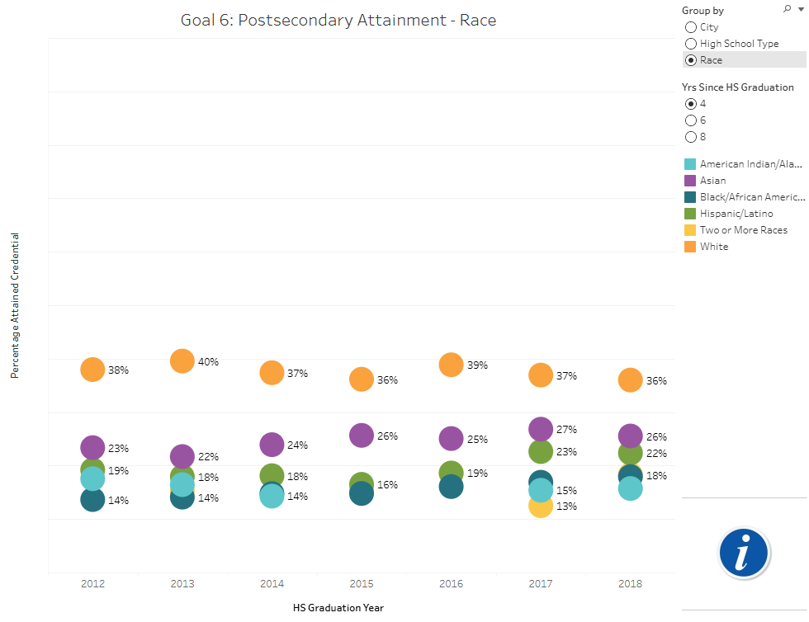

Develop quality questions:
Focus on a program, program component, or outcome area.
Postsecondary results for public school graduates in Minneapolis and Saint Paul, MN
Notes:
- Describe limitations of this cross-sectional approach to viewing educational data and how it differs from longitudinal

Slide 7
Develop quality questions:
List top 3 questions that you’d like to prioritize.
What are the characteristics of students enrolling and obtaining a credential?
What is the experience of students in the postsecondary transition and beyond?
What are the factors that influence economic mobility?

Slide 8



Develop quality questions:
Categorize them:
Descriptive questions
Normative questions
Cause and effect questions
What are the characteristics of students enrolling and obtaining a credential? (DESCRIPTIVE)
What is the experience of students in the postsecondary transition and beyond? (DESCRIPTIVE)
What are the factors that influence economic mobility? (DESCRIPTIVE)
Notes:
- Definitions of each of these types of questions

Slide 9
Developing quality questions
Focus on a program, program component, or outcome area
List top 3 questions that you’d like to prioritize
Categorize them:
Descriptive questions (“what is questions”)
Normative questions (“what is vs. what should be”)
Cause and effect questions (“did x increase y”)
Review and revise questions to be (find a partner - different org - and swap questions):
Clear, specific, and well-defined
Measureable
Aligned with your logic model*
Notes:
Each step is done separately with allotted time for each step.

Slide 10

Create a strategy for gathering the relevant data
Who:
When:
Which outcomes:
Track down the relevant data:
Local agencies (school districts, city/county agencies)
State agencies (department of education, department of health, etc.)
Federal agencies (NCES, Census, Bureau of Labor Statistics)
Universities (Economics department, Education department, etc.)
Program provider

Slide 11
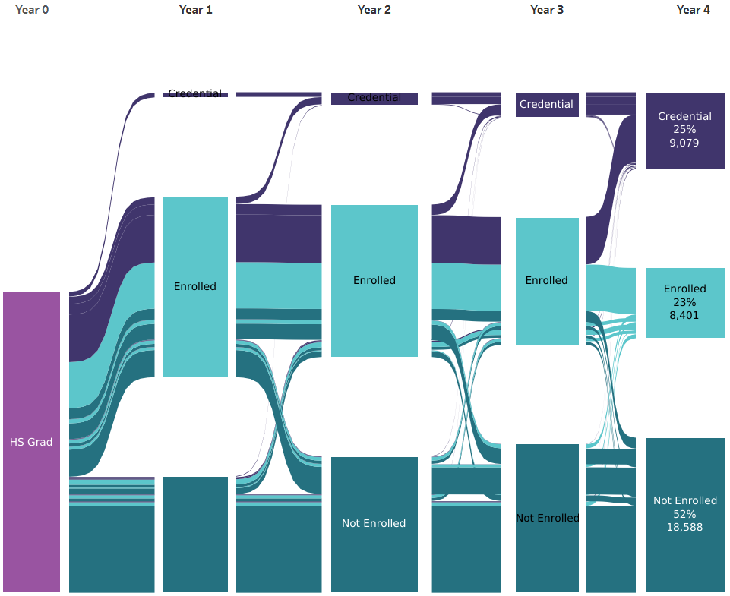
Who are these students?
What was their high school experience?
What was their postsecondary experience?
How can we support future success?

Slide 12




College Partners
ILEAD (Identity, Leadership, Excellence, Accountability, and Dedication)
We Thrive
BTEG (Bridging the Equity Gap)
American Indian Success Program
Notes:
Post-Secondary Institutions
The SLEDs data showed that a lot of our students choose Minneapolis College and St. Paul College.
We brought this data to them, and they were not surprised. They said, "Yeah, we know that. What are we doing with that data?"
They had already created programs specifically to address belonging.
St. Paul College:
I LEAD: A network for young men of color to find belonging and support each other.
We Thrive: A similar program created for young women on campus.
Minneapolis College: They have similar programs focused on their African-American and American Indian students.
Generation Next saw an opportunity to bring the leads of these programs together.
These institutions could be seen as competitors for students, but in this space, they started to see each other as colleagues.
We've been able to provide professional development opportunities for both the students and the faculty/staff involved in these programs. Teams from both colleges (pictured on the right) showcased these practices at the annual StriveTogether national convening in San Francisco in September 2023. Along with Trumanue Lindsey, Jr., Vice President of Equity and Inclusion at Minneapolis College, and Pepe Wonosikou, Dean of Student Success at Saint Paul College, we hosted a workshop on Culturally Sustaining Practices: An Ecosystem of Student & Administrative Collaboration. Om Harris and Mahad Abdishakur, student leaders, joined Lindsey and Wonosikou to share their experiences in the iLEAD (Identity, Leadership, Excellence, Accountability, and Dedication) Fellowship Program at Saint Paul College and the Bridging the Equity Gap (BTEG) Scholarship Program at Minneapolis College.

Slide 13
Activities
Develop quality questions.
Create a strategy for gathering the relevant data.

Slide 14
Developing quality questions
Focus on a program, program component, or outcome area
List top 3 questions that you’d like to prioritize
Categorize them:
Descriptive questions (“what is questions”)
Normative questions (“what is vs. what should be”)
Cause and effect questions (“did x increase y”)
Review and revise questions to be (find a partner - different org - and swap questions):
Clear, specific, and well-defined
Measureable
Aligned with your logic model*
Notes:
Each step is done separately with allotted time for each step.

Slide 15
Create a strategy for gathering the relevant data
Who:
When:
Which outcomes:
Track down the relevant data:
Local agencies (school districts, city/county agencies)
State agencies (department of education, department of health, etc.)
Federal agencies (NCES, Census, Bureau of Labor Statistics)
Universities (Economics department, Education department, etc.)
Program provider

Slide 16
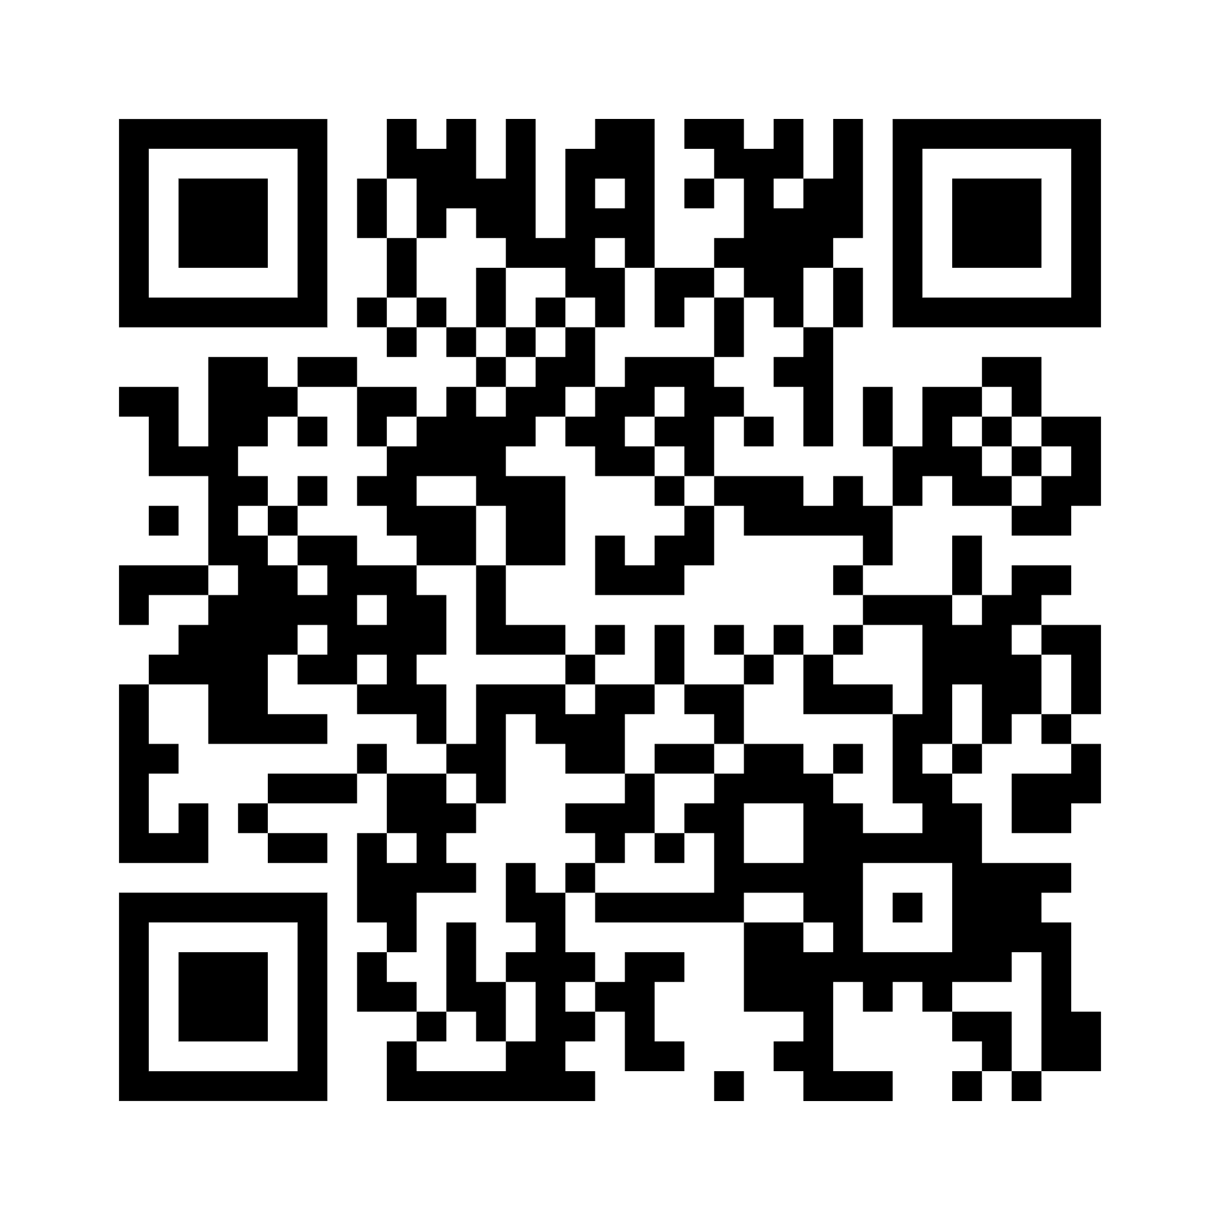
Resources

Slide 17
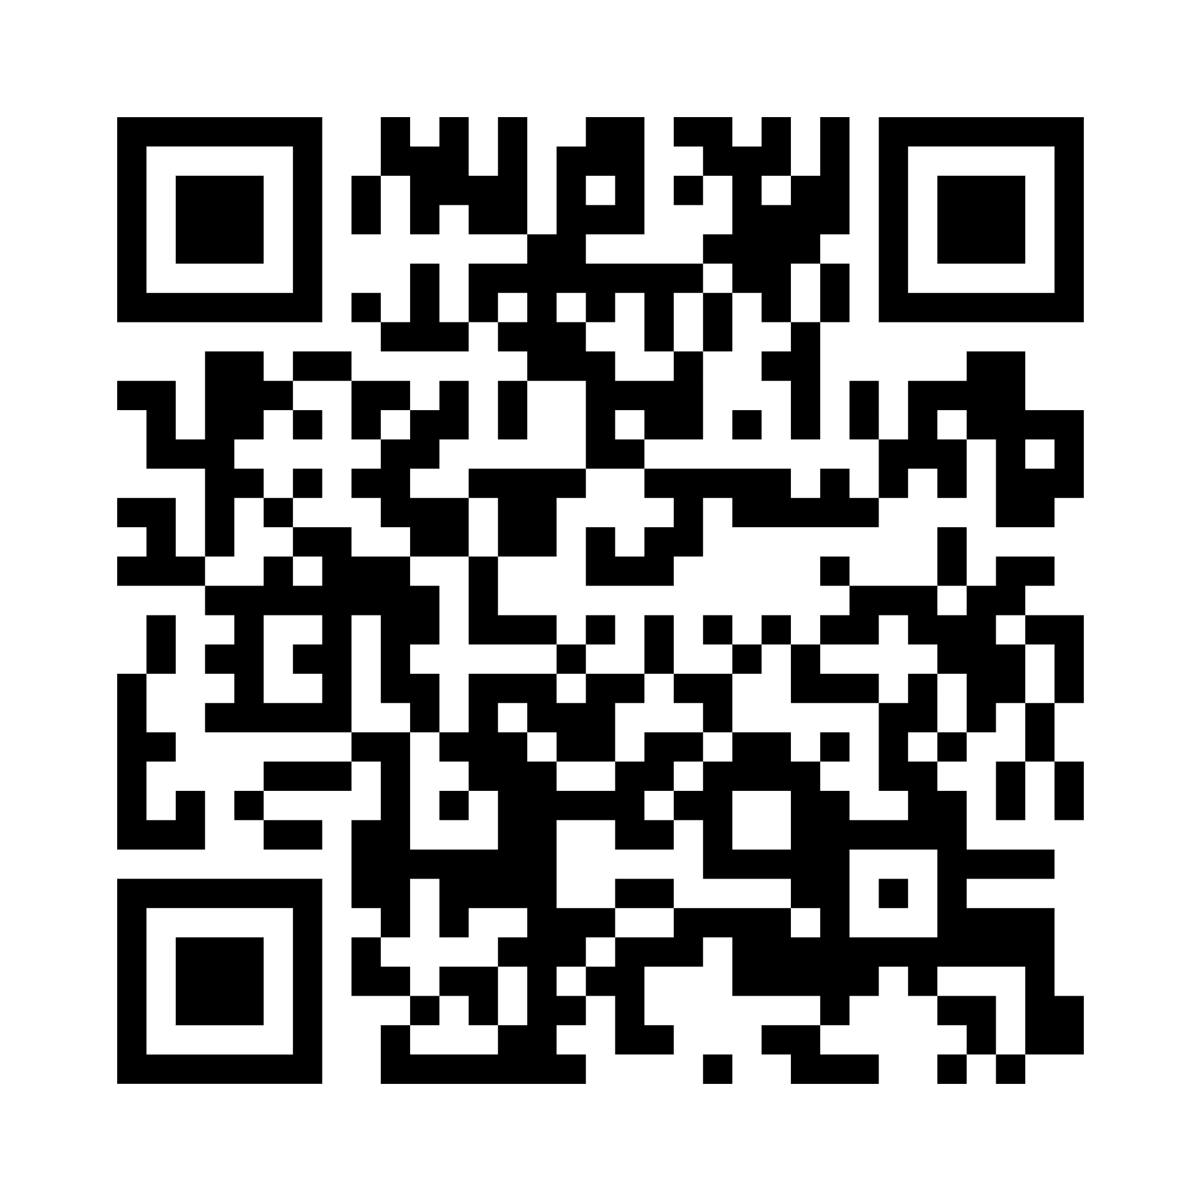
Want to follow up?

Slide 18





Follow us!
Join the conversation
StriveTogether
@StriveTogether
StriveTogether
#ConveneC2C
@StriveTogether
StriveTogether
18

